Slide 1
Covid-19 Vaccination Study
A 2021 study on symptoms and outcomes in hospitalized Covid-19 Patients

Slide 2
Clinical Trial Details
The Inner Workings of the Trial

Slide 3
Clinical Trial Details
Time frame:
Data collected from June 01, 2021 – June 07, 2021
Data collected of participants hospitalized within the time period between December 15, 2020 – May 15, 2021 (15 months)
Data collected involved hospital documentation
Groups Involved:
Participants involved three groups of individuals documented due to hospitalization from COVID-19
Unvaccinated: positive lab COVID-19 testing with no record of immunization against COVID-19 or first-dose vaccination after symptom onset.
Partially Vaccinated: positive lab COVID-19 testing and symptom onset after single dose of mRNA (Pfizer, Moderna) vaccine or, <14 days after second dose of mRNA vaccine or <14 days after administration of single dose of viral vector vaccine (Johnson & Johnson)
Fully Vaccinated: positive lab COVID-19 testing and symptom onset >14 days since administration of second dose of mRNA vaccine, or >14 days since administration of viral vector vaccine (Johnson & Johnson)

Slide 4
Clinical Trial Details Cont.
Country of Enrollment
United States – all participants
Primary Outcome
Primarily what is being looked at in the study
Participants presented to Emergency Center or Hospitalized for COVID-19
Secondary Outcome
Secondarily what is being looked at in the study
Data for secondary outcome in partially vaccinated and fully vaccinated individuals is lacking as of this study; not enough numbers to look at
Patients with severe infection; ICU admission, mechanical ventilation, or in-hospital mortality

Slide 5
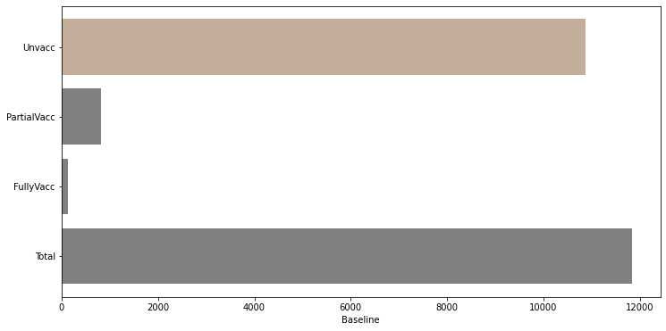
Hospitalized Participants Fully Vaccinated, Partially Vaccinated, and Unvaccinated
Characterizing case-study participants:
Individuals hospitalized due to COVID-19
Three groups – unvaccinated, partially vaccinated, and fully vaccinated

Slide 6
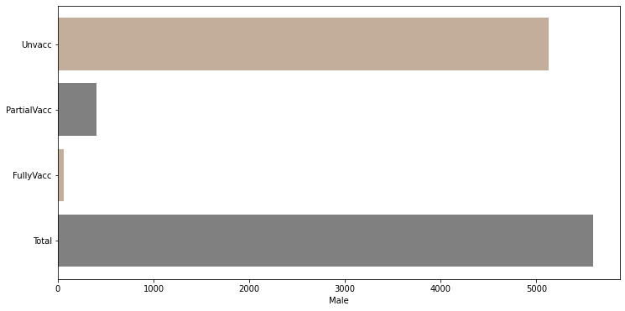
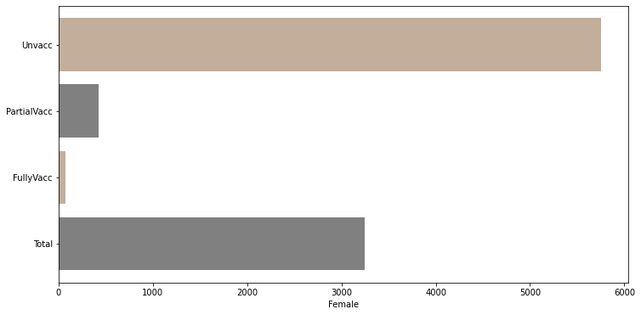
Gender Distribution
Number of total male participants slightly outnumbered female participants
Number of total unvaccinated female participants slightly outnumber unvaccinated male participants

Slide 7
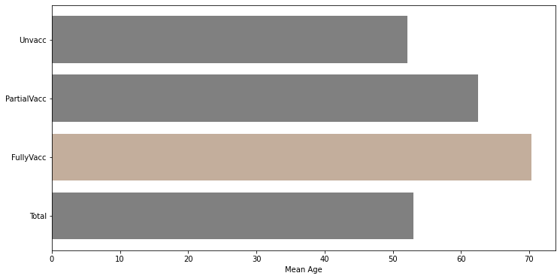
Mean Age
Mean age of participants:
Unvaccinated mean age was about 53 years old
Partially vaccinated mean age was about 63 years old
Fully vaccinated mean age was about 70 years old
Mean age of all participants was about 54 years old.

Slide 8
Our Focus
In this trial the low number of vaccinated and partially vaccinated invdividuals involved makes it very difficult to determine trends when including those two groups.
We can determine that there has been significantly more unvaccinated individuals hospitalized than those who were vaccinated or even partially vaccinated
The rest of our study will focus on details surrounding the unvaccinated group only.

Slide 9
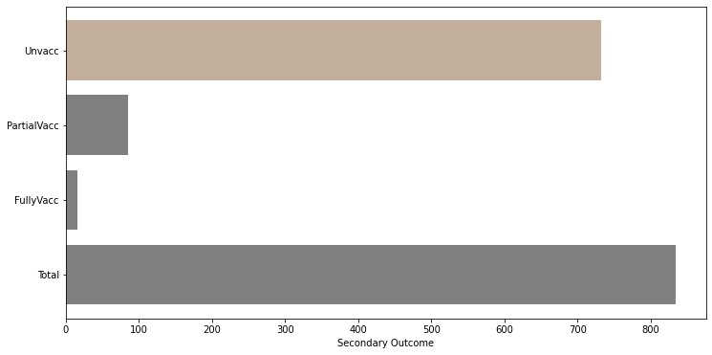
Number of Secondary Outcome Instances
Number of instances of secondary outcomes in hospitalized individuals included:
About 750 instances of unvaccinated individuals
About 100 instances of partially vaccinated individuals
About 10 instances of fully vaccinated individuals

Slide 10
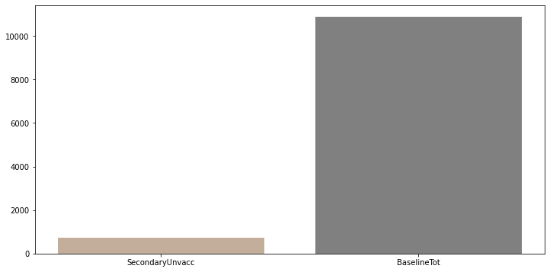
Instances of Secondary Outcome vs Baseline Numbers
6.7% of total unvaccinated hospitalizations led to secondary problems, including severe infection, ICU admission, oxygen therapy, in-hospital mortality, etc.

Slide 11
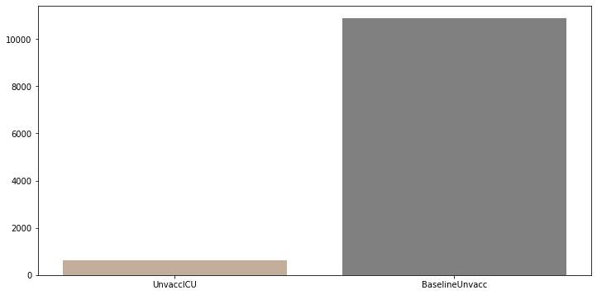
Unvaccinated ICU Admissions
5.689338235294118% of total unvaccinated hospitalizations led to ICU admissions

Slide 12
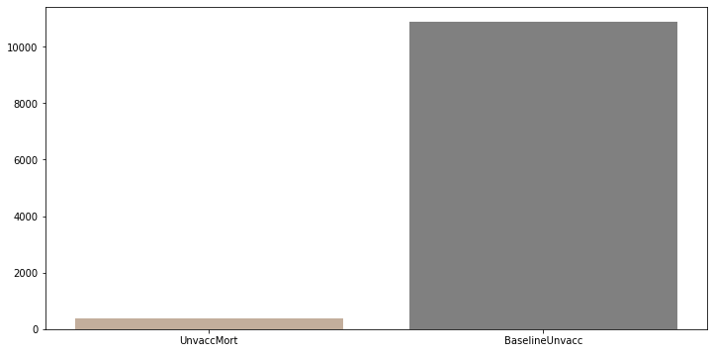
In-Hospital Mortality Rates
3.5294117647058822% of total unvaccinated hospitalizations led to in-hospital mortalities

Slide 13
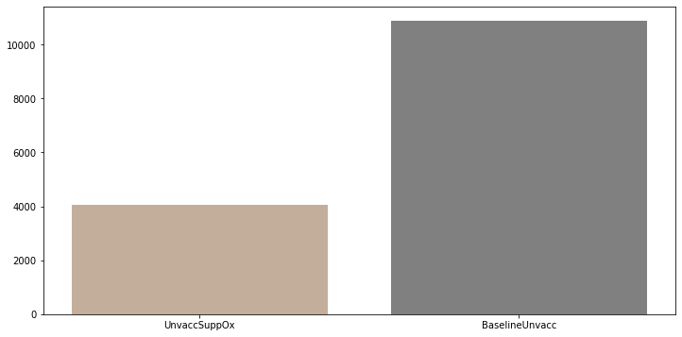
Supplemental Oxygen Rates
37.17830882352941% of total unvaccinated hospitalizations led to required supplemental oxygen

Slide 14
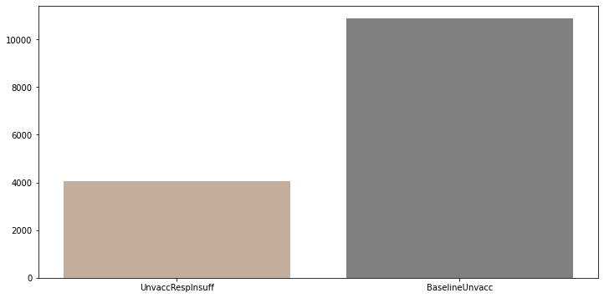
Respiratory Insufficiency Rates
37.1875% of total unvaccinated hospitalizations led to respiratory insufficiency

